Slide 1
Decision Tree Method ML ALGORITHM

Slide 2
MACHINE LEARNING METHODS
There is lot of overlapping between statistical modeling and machine learning. The Regression Models are used extensively in ML applications.
Logistic Regression
Support Vector Machines
K Nearest Neighbours Method (KNN)
Random Forest
Decision Trees
Naive Bayes Classifier
Linear Regression
Regression and Machine Learning Algorithms

Slide 3
Introduction to Decision Tree
Decision Tree learning is one of the predictive modeling techniques.
Classification tree - when the predicted outcome is the class to which the data belongs.
Regression tree - when the predicted outcome can be considered a real number (e.g. the price of a house, or a patient’s length of stay in a hospital).
Decision Tree breaks down a data set into smaller subsets and presents association between target variable (dependent) and independent variables as a tree structure. A final result is a tree with decision nodes and leaf nodes. A decision node has two or more branches and leaf node represents a classification or decision.
The term Classification And Regression Tree (CART) analysis is an umbrella term used to refer to both of the above procedures, first introduced by Breiman et al.

Slide 4
Types of Decision Tree
Trees used for regression and trees used for classification have some similarities - but also some differences, such as the procedure used to determine where to split.
There are many specific decision-tree algorithms. Notable ones include:
ID3 (Iterative Dichotomiser 3)
CHAID (CHi-squared Automatic Interaction Detector). Performs multi-level splits when computing classification trees.
Conditional Inference Trees: Statistics-based approach that uses non-parametric tests as splitting criteria, corrected for multiple testing to avoid overfitting. This approach results in unbiased predictor selection and does not require pruning.

Slide 5
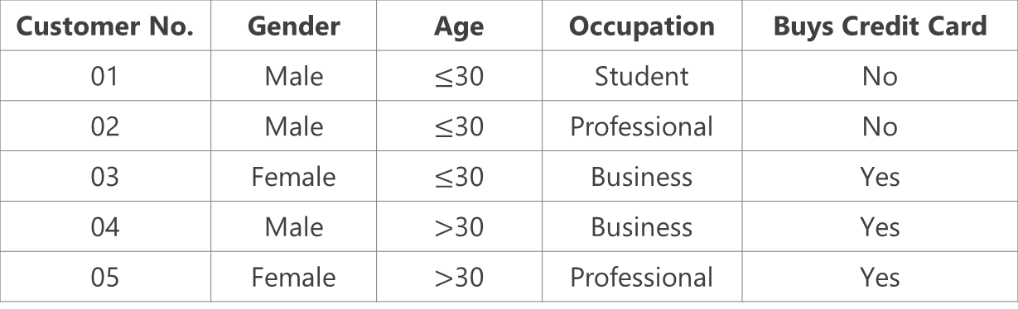
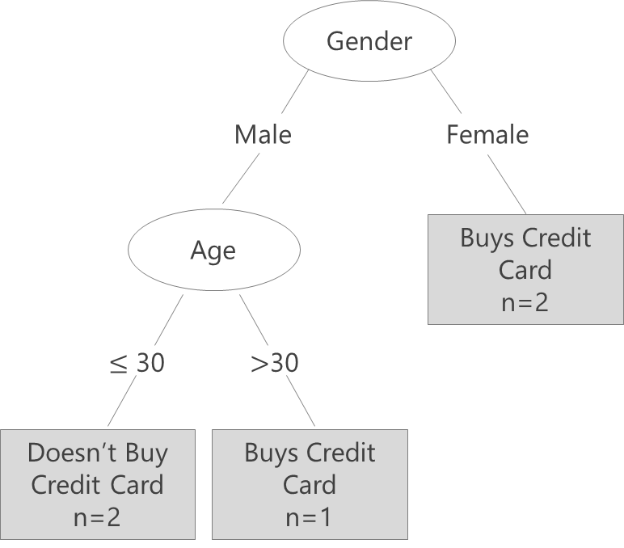
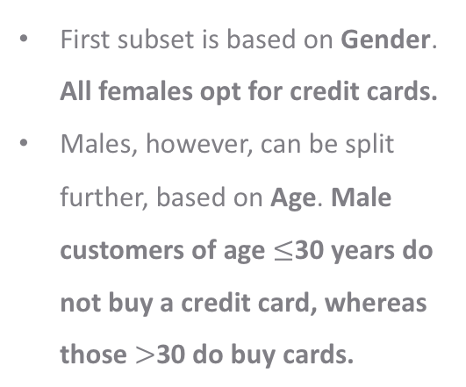
Decision Tree – Basic Framework
Suppose we have information about 5 customers and their decision about buying a credit card.
This data can be represented as a Decision Tree:
First subset is based on Gender. All females opt for credit cards.
Males, however, can be split further, based on Age. Male customers of age $≤$30 years do not buy a credit card, whereas those $>$30 do buy cards.

Slide 6
Decision Tree – Basic Components
Component | Description | Alternate terms
Root node | Has no incoming edges and zero or more outgoing edges | Parent node
Inner node | Each has exactly one incoming edge and two or more outgoing edges | Decision nodes / Child nodes
Leaf node | Each has exactly one incoming edges and no outgoing edges | Terminal nodes
Branches | Categories of attributes | Edges

Slide 7
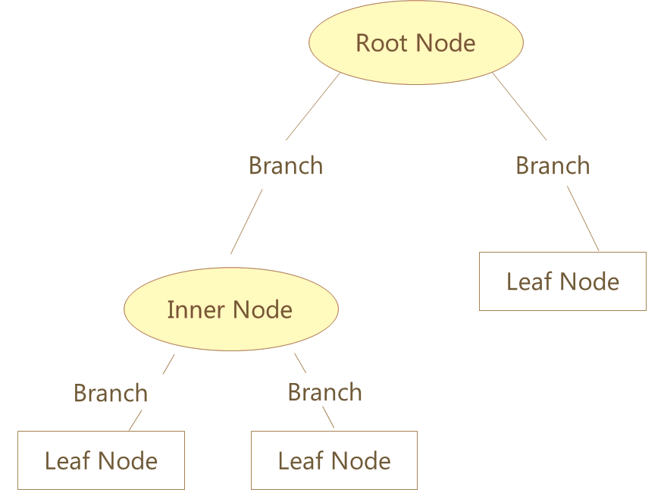
Decision Tree – Basic Components
The first variable used for separating the observations
Categories of Attribute
Next attribute for separating the observations
Class Labels
*
Class labels show observations belong to which class. The leaf node also shows Number of observations and Error rate (Actual classification vs classification given by the tree)

Slide 8
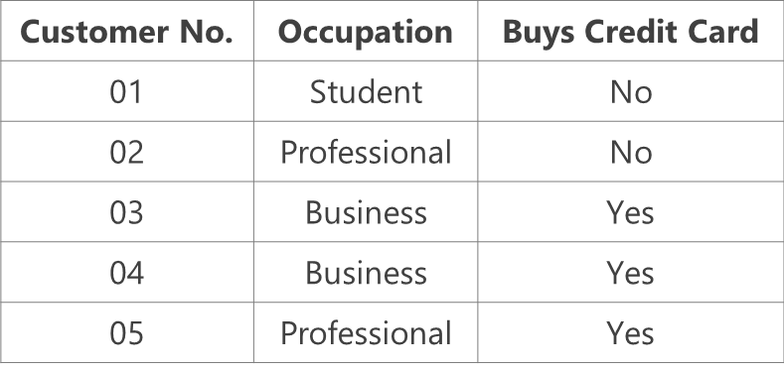
Binary and Non Binary Trees
Consider the same example illustrated earlier.
Occupation is the nominal attribute under consideration, with three distinct categories.
There are two ways in which a decision node can be split into further branches:
Occupation
Occupation
Student
Not a Student {Professional or Business}
Student
Business
Professional
Binary Tree
Non-Binary Tree

Slide 9
Introduction to CHAID
CHAID is a type of decision tree technique used for classification problem. The CHAID algorithm was developed in South Africa and was published in 1980 by Gordon V. Kass, who had completed a PhD thesis on this topic.
The acronym CHAID stands for Chi Square Automatic Interaction Detection.
It builds Non-binary trees (trees where more than 2 branches can attach to the root node or any node).
chi-square test of independence is used at each step to determine the strength of relationship between dependent and independent variables.
CHAID can be effectively applied in case of large data sets.
The independent variables should be categorical so if data contains continuous predictors then they must be converted to categorical variables.

Slide 10
Case Study – Employee Churn Model
Background
Objective
Available Information
A company has comprehensive database of its past and present workforce, with information on their demographics, education, experience and hiring background as well as their work profile. The management wishes to see if this data can be used for predictive analysis, to control attrition levels.
To develop an Employee Churn model via Decision Tree
Gender, Experience Level (<3, 3-5 and >5 years), Function (Marketing, Finance, Client Servicing (CS)) and Source (Internal or External) are independent variables
Status is the dependent variable (=1 if employee left within 18 months from joining date)
Sample size is 83

Slide 11
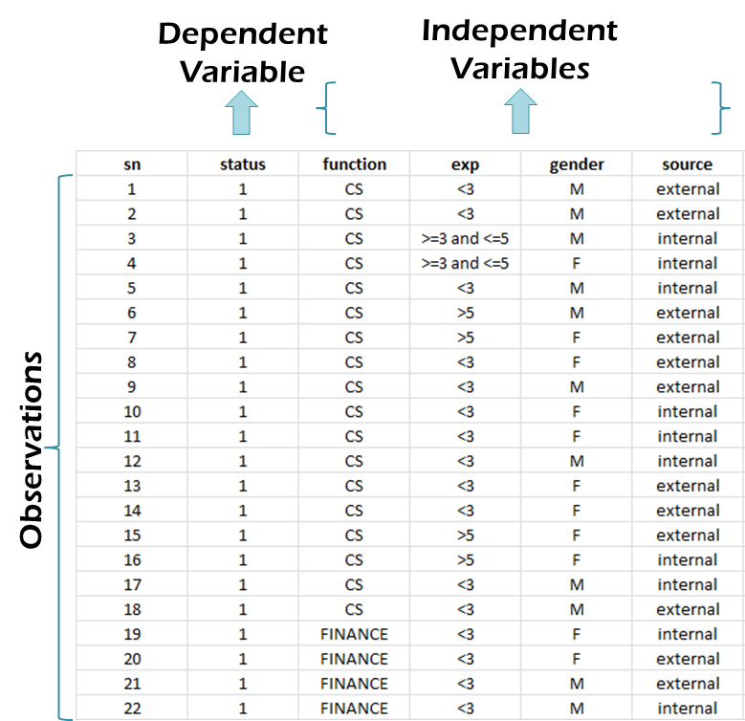
Data Snapshot
EMPLOYEE CHURN DATA
Columns | Description | Type | Measurement | Possible values
sn | Serial Number | - | - | -
status | = 1 If the Employee Left Within 18 Months of Joining = 0 Otherwise | Binary | 1,0 | 2
function | Employee Job Profile | Categorical | CS, FINANCE, MARKETING | 3
exp | Experience in Years | Categorical | <3,3-5,>5 | 3
gender | Gender of the Employee | Categorical | M,F | 2
source | Whether the Employee was Appointed via Internal or External Links | categorical | external, internal | 2

Slide 12
Case Study: Employee Churn Model
CHAID can be used to develop employee churn model.
Independent variables can be:
Gender
Experience Level (<3, 3-5 and >5 years)
Function (Marketing, Finance, Client Servicing)
Source (Internal or External)
Dependent variables is "status" (=1 if employee left within 18 months from
joining date)

Slide 13
CHAID Algorithm
CHAID algorithm includes following steps:
Preparing predictors
Merging categories
Selecting the split variable
Preparing predictors
All continuous predictor variables are converted to categorical variables. Example: Experience Level (<3, 3-5 and >5 years).
The categorical variable are considered with the natural categories
Example: Function (Marketing, Finance, Client Servicing).

Slide 14
CHAID Algorithm
Merging categories
In this step categories of predictors are assessed for possible merging.
For every predictor all possible pairs of categories are considered.
Example: For predictor "function", Marketing- Finance, Marketing-CS and Finance-CS are assessed pairwise.
The chi-square test of independence is used to decide whether categories in the pair are to be combined or not.
The level of significance value used in the testing is named as alpha-to-merge.
If the adjusted p-value (Bonferroni) for a particular pair is greater then alpha-to-merge ,then the categories are merged together .
This merging is continued until no categories can be merged further.

Slide 15
CHAID Algorithm
Selecting the split variable
The Chi-square test of independence between dependent variable and each of predictors is performed.
Predictor variable with the smallest adjusted p-value (Bonferroni) is considered as a first split variable and appears at first node.
If there is tie between 2 predictors then the predictor with largest chi-square statistics value is considered as the split variable.
The level of significance value is named as alpha-to-split is decided apriori.
The process is repeated at each node using subset of data defined by the node.
If the smallest (Bonferroni) adjusted p-value for any predictor is greater than some alpha-to-split value, then no further splits will be performed, and the respective node is a terminal node.
Continue this process until no further splits can be performed .

Slide 16
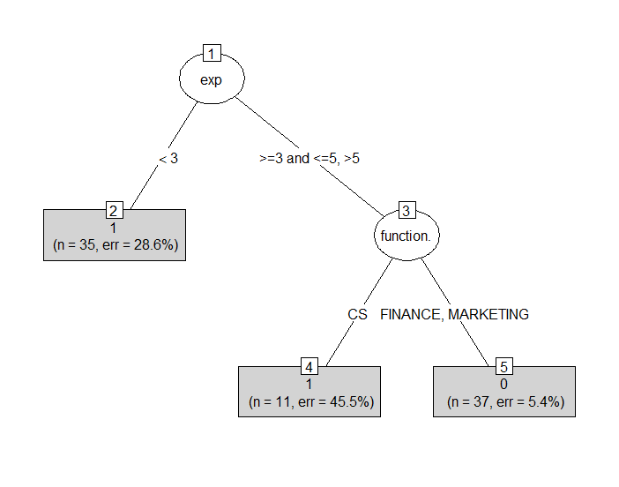
Decision Tree in R CHAID Implementation in "CHAID"
empdata<-read.csv(file.choose(),heade=T,stringsAsFactors =T)
install.packages("partykit")
install.packages("CHAID", repos = "http://R-Forge.R-project.org", type = "source")
library(CHAID)
empdata$status<-as.factor(empdata$status) # # classification problem
tree<-chaid(formula=status~function.+exp+gender+source,data=empdata)
plot(tree,type="simple")
__________________________________________________________________
Exp is the first split variable followed by function.
Gender and Source are not appearing in the decision tree.
35 employees with
exp<3.Out of which 25
Have status=1 (majority=1)
25/35=0.714.
Err=28.6%

Slide 17
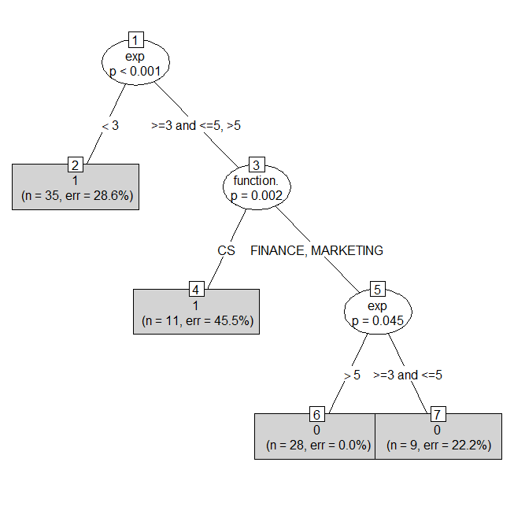
Decision Tree in R…. CHAID-like Implementation in "partykit"
empdata<-read.csv(file.choose(),heade=T,stringsAsFactors =T)
install.packages("partykit")
library(partykit)
empdata$status<-as.factor(empdata$status) # classification problem
ctree<-partykit::ctree(formula=status~function.+exp+gender+source,
data=empdata)
plot(ctree,type="simple")
_________________________________________________________________
35 employees with
exp<3.
Out of which 25
have Y=1 and 10 have Y=0
25/35=0.714

Slide 18
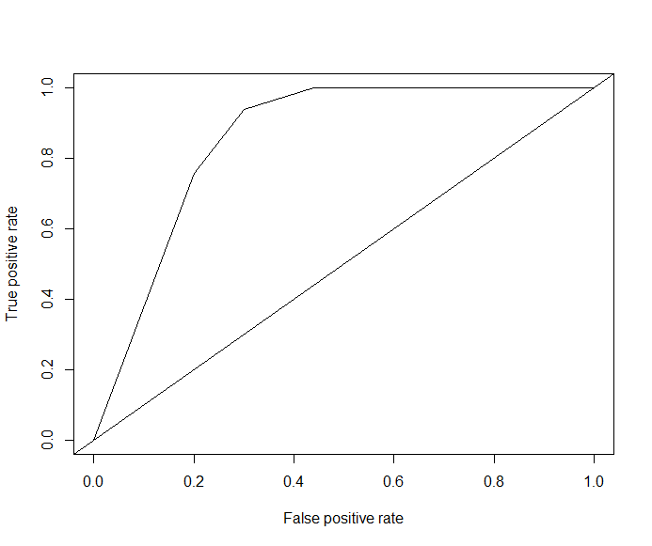
Decision Tree in R…. ROC Curve for "partykit" tree
predtree<-predict(ctree,empdata,type="prob")
library(ROCR)
pred<-prediction(predtree[,2],empdata$status)
perf<-performance(pred,"tpr","fpr")
plot(perf)
abline(0,1)
## Area under ROC Curve in R (AUC)
auc<-performance(pred,"auc")
auc@y.values
__________________________________________________________________
[[1]]
[1] 0.8563636

Slide 19
Note on R Packages
Package CHAID in R has implemented Chaid algorithm as it was developed. The CHAID package is not available on CRAN. It can be downloaded from R-forge.
The package "partykit" has a function called 'ctree' which implements Chaid algorithm to some extent. This package is available on CRAN.
ctree function in partykit package can also handle continuous predictors.
The package "rpart" handles classification as well as regression problems using decision tree. (CART: Classification and Regression Trees)
library(rpart)
tree <- rpart(Y ~ X1 + X2 + X3, method="class", data=…)
tree <- rpart(Y ~ X1 + X2 + X3, method="anova", data=…)

Slide 20
THANK YOU!!

